Slide 1
Automata and Theory of Computation
CSE 417
Lecture 1-2
Notes:
Farazul H Bhuiyan
Lecturer
Dept. of CSE
BRAC University
Bangladesh

Slide 2
Student’s Introduction
Name
I will try to remember your names. But if you have a Long name, please let me know how should I call you ☺
Major and Academic status
Thoughts on Programming
Java, C/C++, VB, Matlab, Scripts etc.
Expectation from this course

Slide 3
Instructor
DR. NAFEES MANSOOR
Assistant Professor
Department of Computer Science and Engineering
Email: nafees.mansoor@ulab.edu.bd
Office: Room PC315
Class Hours: 11:30 - 13:00 (S/T)
Consultation Hours: 13:30 – 14:30 (S/T)
Note: Available by appointment at other hours (e.g. email)

Slide 4
Focus
Introduction to the theory of computation
Topics that will be covered in this course
Finite automata (DFA, NFA)
Regular expressions
Minimization of DFA, equivalences of DFA and NFA
Regular expressions
Context free grammar
Push Down Automata
Turing machine
Notes:
Farazul H Bhuiyan
Lecturer
Dept. Of CSE
BRAC University

Slide 5
Contents
ILO | Topic | Teaching Strategy | Assessment Strategy | Number of Sessions
1-2 | Introduction to Automata and Theory of Computation | Lecture Exercise | Q/A Assignment | 4
1-3 | Finite State Machines | Lecture Exercise | Q/A | 6
1-3 | Regular Expressions | Lecture Exercise | Q/A | 3
1-5 | Context Free Grammar | Lecture Exercise | Q/A Assignment | 5
1-5 | Push Down Automata | Lecture Exercise | Q/A | 2
1-5 | Turing Machine & Decidability | Lecture Exercise | Q/A Assignment | 4
 |  |  | Total | 24
Notes:
Farazul H Bhuiyan
Lecturer
Dept. Of CSE
BRAC University

Slide 6
Weight Assessments
Assignments 10%
Quiz 10%
Class Participation 10%
Midterm 20%
Final Exam 50%
Notes:
Farazul H Bhuiyan
Lecturer
Dept. Of CSE
BRAC University

Slide 7
Grading
A relative or bell-curve grading system will be followed, so that the majority will receive a middle grade, and only a few will get A/A-, or F. The course teacher will assign mark ranges to each letter grade, taking into account the assessment components and assigned weights, difficulty level, average academic ability of the class, etc
I have a simple policy
Grade is something
That shouldn't be given
It should be
earned

Slide 8
Reference Books
Introduction to the theory of computation
Introduction to automata theory, languages, and computation
by Michael Sipser
by John E. Hopcroft, Rajeev Motwani and Jeffrey D. Ullman
Notes:
Farazul H Bhuiyan
Lecturer
Dept. Of CSE
BRAC University

Slide 9

Questions

Slide 10
Why to study Automata Theory
To understand the limits of computation
Some problems require more resources to compute, and others may be computed with less.
To study these issues we need mathematical notions of “resource” and “compute”.
We’ll study different “machine models” (finite automata, pushdown automata). . .
Notes:
Farazul H Bhuiyan
Lecturer
Dept. Of CSE
BRAC University

Slide 11
Why to study Automata Theory
Direct application in creating
Compilers,
Text editors,
Communications protocols,
Hardware design, . . .
First compilers took several person-years; now can be written by a single student in one semester ☺ thanks to theory of parsing.
To learn to think analytically about computing
Notes:
Farazul H Bhuiyan
Lecturer
Dept. Of CSE
BRAC University

Slide 12
Theory of Computation
Divided into three areas
Computability Theory
Classifies problems as solvable or not solvable
Complexity Theory
Classifies problems as easy ones and hard ones
Automata Theory
Deals with definitions and properties of mathematical models of computation
Notes:
Farazul H Bhuiyan
Lecturer
Dept. Of CSE
BRAC University

Slide 13
Mathematical Notions and Terminology
Notes:
Farazul H Bhuiyan
Lecturer
Dept. Of CSE
BRAC University

Slide 14
Set Theory
What are Sets?
Sets are collections of objects
S={a, b, c} refers to the set
whose elements are a, b and c.
a ∈ S
means “a is an element of set S”.
d ∉ S
means “d is not an element of set S”.
{x ∈ S | P(x)}
is the set of all those x from S such that P(x) is true.
E.g., T={x ∈Z | 0<x<10} .

Slide 15
Set Theory: Relation between Sets
Definition: Suppose A and B are sets. Then
A is called a subset of B: A ⊆ B iff
every element of A is also an element of B.
Symbolically,
A ⊆B ⇔ ∀x, if x∈A then x ∈B.
A ⊄ B ⇔ ∃x such that x ∈ A and x∉B.
B
A
A
B
A ⊄ B
A ⊆ B

Slide 16
Set Theory: Relation between Sets
Definition: Suppose A and B are sets. Then
A equals B: A = B
iff every element of A is in B and
every element of B is in A.
Symbolically,
A=B ⇔ A⊆B and B⊆A .
Example: Let A = {m∈Z | m=2k+3 for some integer k};
B = the set of all odd integers.
Then A=B.

Slide 17
Set Theory: Operations
Definition: Let A and B be subsets of a set U.
1. Union of A and B: A ∪ B = {x∈U | x∈A or x∈B}
2. Intersection of A and B:
A ∩ B = {x∈U | x∈A and x∈B}
3. Difference of B minus A: B−A = {x∈U | x∈B and x∉A}
4. Complement of A: A^{c} = {x∈U | x∉A}
Ex.: Let U=R, A={x ∈R | 3<x<5}, B ={x ∈R| 4<x<9}. Then
1) A ∪ B = {x ∈R | 3<x<9}.
2) A ∩ B = {x ∈R | 4<x<5}.
3) B−A = {x ∈R | 5 ≤x<9}, A−B = {x ∈R | 3<x ≤4}.
4) A^{c} = {x∈R | x ≤3 or x≥5}, B^{c} = {x∈R | x ≤4 or x≥9}

Slide 18
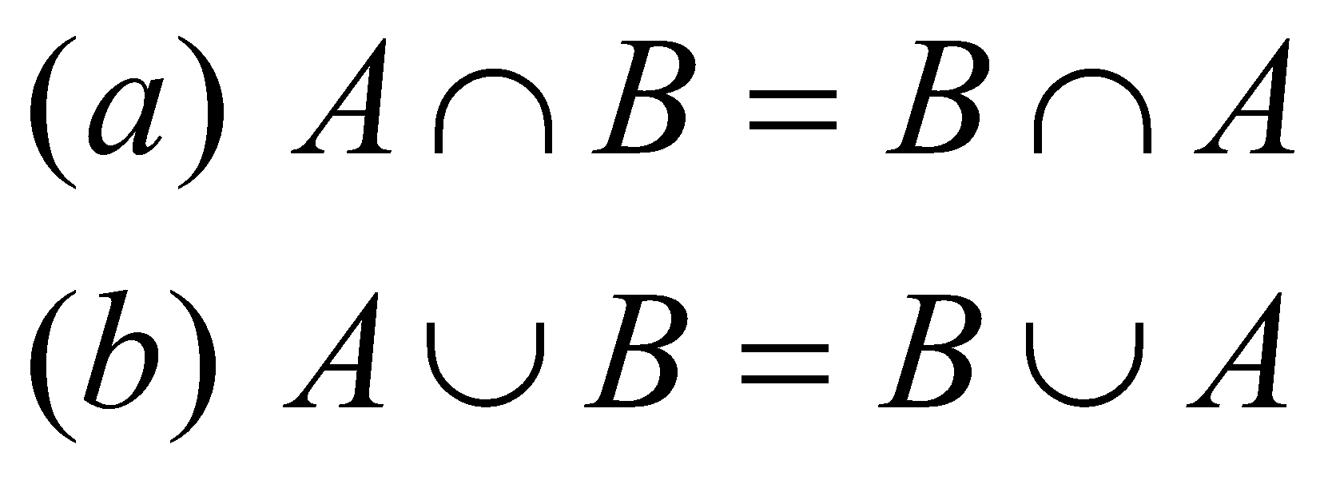
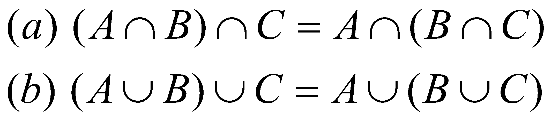
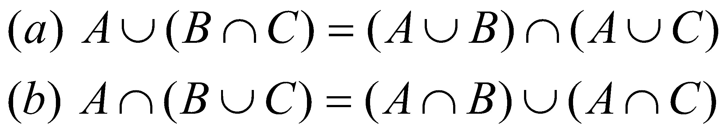
Set Theory: Properties
Commutative Laws:
Associative Laws:
Distributive Laws:

Slide 19
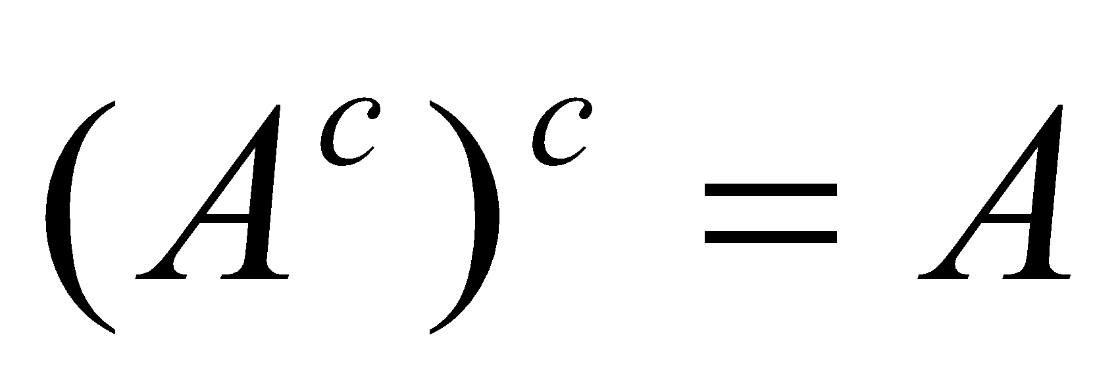
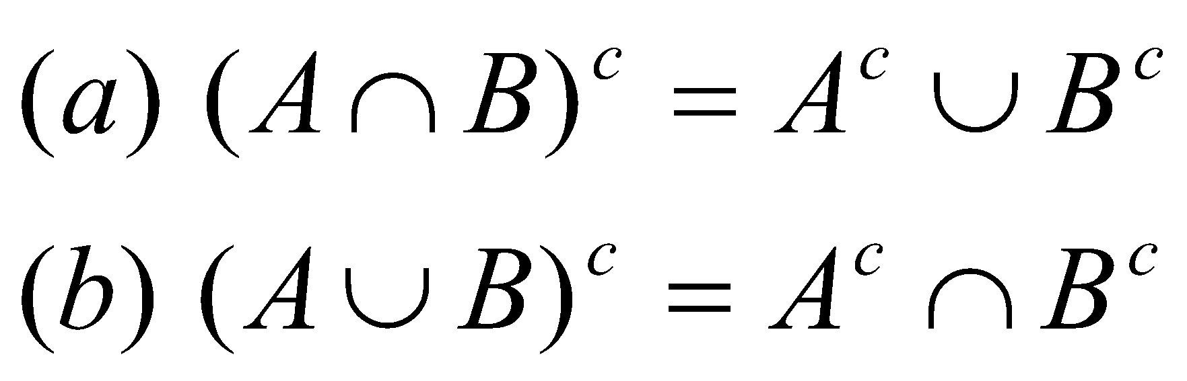
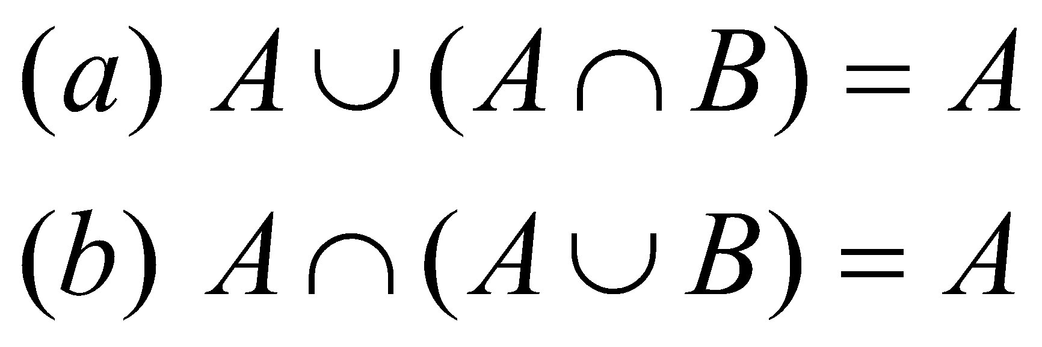
Set Theory: Properties
Double Complement Law:
De Morgan’s Laws:
Absorption Laws:

Slide 20
Set Theory: Empty Set
The unique set with no elements
is called empty set and denoted by ∅.
Set Properties that involve ∅ .
For all sets A,
1. ∅ ⊆ A
2. A ∪ ∅ = A
3. A ∩ ∅ = ∅
4. A ∩ A^{c} = ∅

Slide 21
Set Theory: Disjoint Set
A and B are called disjoint iff
A ∩ B = ∅
Sets A₁, A₂, …, A_{n} are called mutually disjoint
iff for all i,j = 1,2,…, n
A_{i} ∩ A_{j} = ∅ whenever i ≠ j .
Examples:
1) A={1,2} and B={3,4} are disjoint.
2) The sets of even and odd integers are disjoint.
3) A={1,4}, B={2,5}, C={3} are mutually disjoint.
4) A−B, B−A and A∩B are mutually disjoint.

Slide 22
Set Theory: Power Set
Definition: Given a set A,
the power set of A, denoted P (A) ,
is the set of all subsets of A.
Example: P ({a,b}) = {∅, {a}, {b}, {a,b}} .

Slide 23
Set Theory: Power Set
Properties:
1) If A ⊆ B then P (A) ⊆ P (B) .
2) If a set A has n elements
then P (A) has 2^{n} elements.

Slide 24
Graph Theory
A graph G(V,E) is two sets of object
Vertices (or nodes) , set V
Edges, set E
A graph is represented with dots or circles (vertices) joined by lines (edges)
The magnitude of graph G is characterized by number of vertices |V| (called the order of G) and number of edges |E| (size of G)

Slide 25
Graph Theory: Applications
Graph (Network) | Vertexes (Nodes) | Edges (Arcs) | Flow
Communications | Telephones exchanges, computers, satellites | Cables, fiber optics, microwave relays | Voice, video, packets
Circuits | Gates, registers, processors | Wires | Current
Financial | Stocks, currency | Transactions | Money
Transportation | Airports, rail yards, street intersections | Highways, railbeds, airway routes | Flights, vehicles, passengers

Slide 26
Graph
Types of graphs
Directed graphs
G=(V,E) where E is composed of ordered pairs of vertices; i.e. the edges have direction and point from one vertex to another.
Undirected graphs
G=(V,E) where E is composed of unordered pairs of vertices; i.e. the edges are bidirectional.

Slide 27
Directed Graph
An edge e ∈ E of a directed graph is represented as an ordered pair (u,v), where u, v ∈ V.
Here u is the initial vertex and v is the terminal vertex, assuming that u ≠ v
2
3
1
V = { 1, 2, 3, 4}, | V | = 4
E = {(1,2), (2,3), (2,4), (4,1), (4,2)}, | E |=5
4

Slide 28
Undirected Graph
An edge e ∈ E of an undirected graph is represented as an unordered pair (u,v)=(v,u), where u, v ∈ V. Also assumed that u ≠ v
2
3
1
V = { 1, 2, 3, 4}, | V | = 4
E = {(1,2), (2,3), (2,4), (4,1)}, | E |=4
4

Slide 29
Degree of a Vertex
Degree of a vertex in an undirected graph is the number of edges incident on it.
In a directed graph, the out degree of a vertex is the number of edges leaving it and the in degree is the number of edges entering it
2
2
3
1
3
1
4
4
The degree of vertex 2 is ???
Ans: 3
The in degree of vertex 2 is 2 and the in degree of vertex 4 is 1

Slide 30
Weighted Graph
A weighted graph is a graph for which each edge has an associated weight, usually given by a
weight function w: E → R
2
2
1.2
0.5
4
2
6
3
1
3
1
0.2
9
2.1
8
4
4

Slide 31
Complete Graph
A complete graph is an undirected/directed graph in which every pair of vertices is adjacent. If (u, v ) is an edge in a graph G, we say that vertex v is adjacent to vertex u.
A
A
B
B
C
C
D
If an undirected graph G has V nodes, how many edges are required to define it as a complete graph
If an directed graph G has V nodes, how many edges are required to define it as a complete graph
Ans: V*(V-1)/2 edges
Ans: V*(V-1) edges

Slide 32
A bipartite graph is an undirected graph G = (V,E) in which V can be partitioned into 2 sets V1 and V2 such that ( u,v) ∈ E implies either u ∈ V1 and v ∈ V2 OR v ∈ V1 and u ∈ V2.
V1
V2
u₁
v₁
u₂
v₂
u₃
v₃
u₄

Slide 33
Let G = (V, E ) be an undirected graph.
The following statements are equivalent,
G is a tree
Any two vertices in G are connected by unique simple path
G is connected, but if any edge is removed from E, the resulting graph is disconnected
G is connected, and | E | = | V | -1
G is acyclic, and | E | = | V | -1
G is acyclic, but if any edge is added to E, the resulting graph contains a cycle
A
B
C
D
E
F

Slide 34
Finite Automata
Finite automata are finite collections of states with transition rules that take you from one state to another.
Original application was sequential switching circuits, where the “state” was the settings of internal bits.
Today, several kinds of software can be modeled by FA.

Slide 35
Representing FA
Simplest representation is often a graph.
Nodes = states.
Arcs indicate state transitions.
Labels on arcs tell what causes the transition.

Slide 36
Finite Automata
Has some number of states
Has a start state and at least one end state
Accepts input that advances it through its states
Can be Deterministic (DFA) or Non-Deterministic (NFA)

Slide 37
Finite Automata
FINITE AUTOMATA IS ALSO KNOWN AS THE FINITE STATE MACHINE
IT IS A 5-TUPLE {Q, Σ, Δ, Q₀, F}WHERE
Q is a finite set of states in the machine
Σ is the input alphabet
δ is the transition from one state to the next state
q₀ is the initial state
F is the set of all accepting states

Slide 38
Finite Automata - DFA
For example: language consist of all strings have even number of 1’s
L={11, 011, 101, 110, 0011, 00…011 …}
0
1
0
even
odd
1

Slide 39
Finite Automata
For example: language consist of all strings have even number of 1’s
Finite Automaton, M:
M ={Q, Σ, δ, q₀, F}
Q={even, odd}
Σ={0,1}
δ is described as
0 1
even {even} {odd}
odd {odd} {even}
q₀ =even
F={even}

Slide 40
Example: Recognizing Strings Ending with“ing”
Not i or g
Not i
Not i or n
i
nothing
Saw i
Saw in
Saw ing
i
g
n
i
Start
anything

